Slide 1



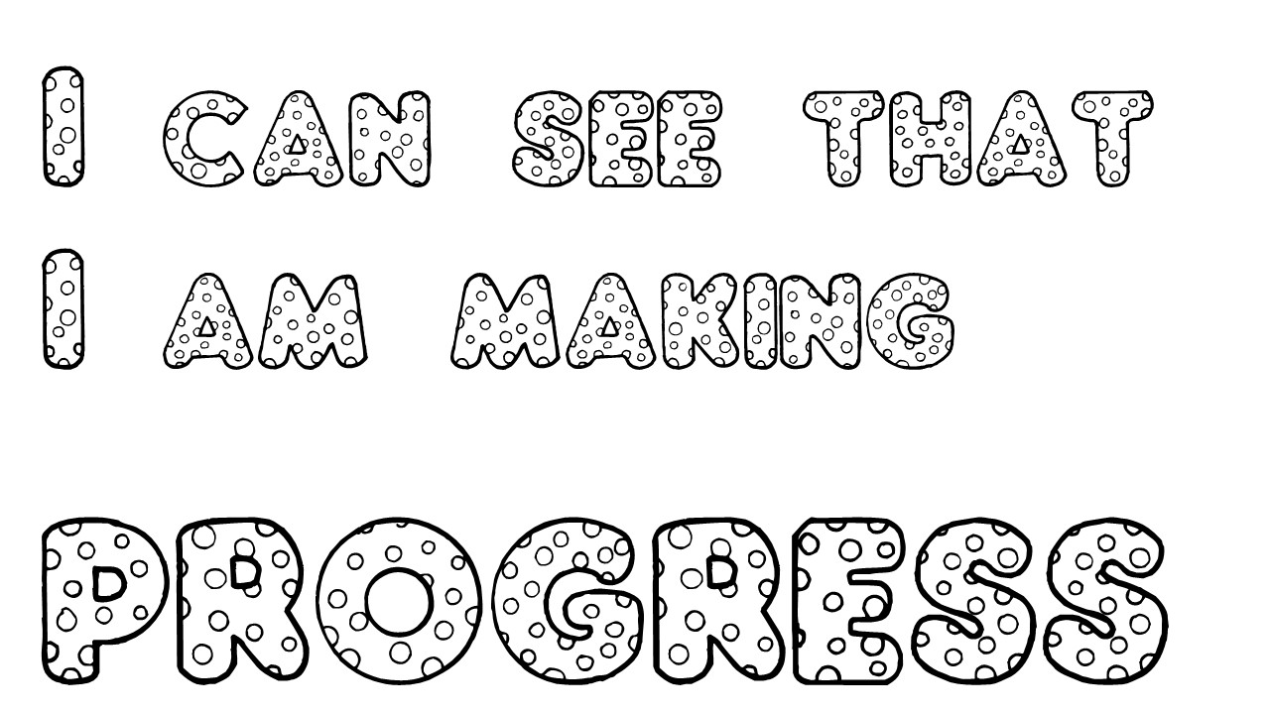
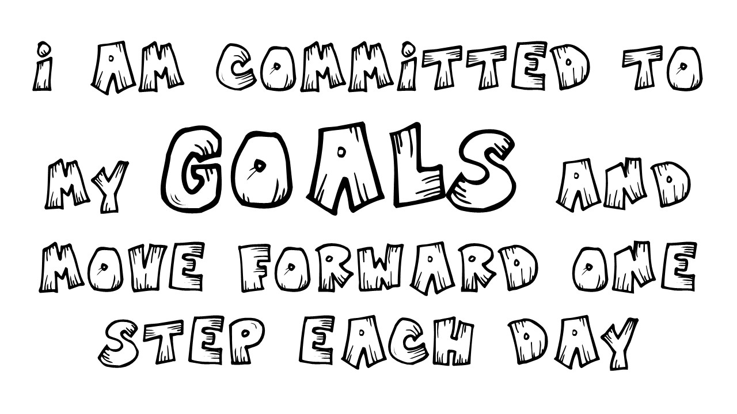




Positive Affirmation
Coloring Sheets
50 Unique Affirmations
10 Fonts
50 Pages
Middle/High School

